Slide 1
GRADUATE SCHOOL APPLICATION MANAGER
HOW TO COMPLETE THE APPLICATION: AN INSTRUCTIONAL GUIDE

Slide 2
Important contact information
For questions about volunteer hours or how to complete the application you can contact:
Jaclyn Levesque
Admissions Coordinator
jl388@buffalo.edu
For questions about the application process and to request course approvals, you can contact:
MaryAnn Venezia
Coordinator for Professional Programs
venezia3@buffalo.edu

Slide 3
APPLICANT TIPS:
KEEP THIS DOCUMENT ON HAND WHEN COMPLETING YOUR APPLICATION.
REFER TO THIS DOCUMENT WITH ANY QUESTIONS YOU MAY HAVE.

Slide 4
WHEN CAN I APPLY?
WHO CAN APPLY?
Undergraduate students currently enrolled in UB.
Those who have successfully completed all prerequisite courses with a minimum prerequisite GPA of 2.8 or higher by the end of the fall semester.
The application system opens November 25th 2019 and closes January 6th 2020.
WHERE CAN I FIND THE APPLICATION?
The application can be found online through this link: https://grad.buffalo.edu/programs/occupational-science-bs-occupational-therapy-ms.html

Slide 5
TECHNICAL STANDARDS
It is important to read and understand the Technical Standards prior to applying to the Occupational Therapy program.
You will need to submit your understanding of the Technical Standards TWICE: Once in your application and again as a separate document.
Be sure to read the Technical Standards Form. You can access this information in the Pre-Major Handbook which can be found online at:
https://sphhp.buffalo.edu/content/dam/sphhp/rehabilitation-science/ot-premajor-handbook.pdf
Signing the form indicates that you have read the Technical Standards; it also indicates what level of accommodations, if any, that you require. Your signature means that you also agree to the requirements listed on page four of the Technical Standards.
For application to the Occupational Therapy professional program, you must simply submit the form with your signature in the appropriate place.

Slide 6
VOLUNTEER FORMS
The volunteer form can be found online at:
https://sphhp.buffalo.edu/content/dam/sphhp/rehabilitation-science/pdfs/OT-Volunteer-Hours-Form.pdf
Your volunteer form MUST be uploaded to your application by January 6th.
If your volunteer form has already been submitted to our office, it will be uploaded to your application AFTER you submit it.
Your original completed volunteer form must be handed in to 532 Kimball by January 15th.
If you have previously applied and submitted volunteer hours and would like them brought forward, send an email request to Jaclyn Levesque, Admissions Coordinator at: jl388@buffalo.edu.
Forms MUST be signed by an OTR or an OTR/L. Forms WILL NOT BE ACCEPTED if they are signed by an OTA/COTA – even if your observation hours are with an OTA/COTA.

Slide 7
VOLUNTEER FORMS – Continued
If you are applying for 2020 admission, your volunteer hours must be completed between January 15, 2018 and January 6, 2020.
The Total Number of Hours MUST BE COMPLETELY FILLED IN. This line CANNOT BE LEFT BLANK.
**No part of the volunteer form can be left blank or it will be considered incomplete.**
Supplemental paperwork attached to your volunteer form DOES NOT REPLACE the volunteer form.
70 hours must be completed.
You may volunteer in no more than 2 sites to meet the 70 hour requirement.
If you volunteer in more than 2 sites for a total of 70 hours – the hours for the additional site(-s) WILL NOT be accepted.

Slide 8
THE APPLICATION

Slide 9
COMPLETING THE APPLICATION
Use your @buffalo.edu email address in your application.
Refer to this document for any questions you may have.
Be sure to review the information you input for accuracy.
REMEMBER: This is a PROFESSIONAL DOCUMENT for a PROFESSIONAL PROGRAM. Capitalize appropriately.
Be sure to write down your assigned log in information. This is a new application system that links directly to HUB. You will NOT be able to start multiple applications!
Make sure your application is complete prior to submitting it.

Slide 10
ACCESSING THE APPLICATION
GO TO: https://grad.buffalo.edu/programs/occupational-science-bs-occupational-therapy-ms.html
Click “Apply Now”

Slide 11
GETTING STARTED
You will need to Create an account

Slide 12
You MUST use your @buffalo.edu email.
Be sure to put in your correct birthdate

Slide 13
After you input your information on the first screen, you will be sent a temporary PIN. You will need that PIN
in order to begin the application.
You will also need to be sure to input the same birthdate information that you entered on the previous screen.
If you input the wrong birthdate, we have no way to correct that.
It is imperative that you carefully review the information that you input.

Slide 14
You will be prompted to create a new password on the next screen.
Be sure to SAVE this information somewhere for reference!

Slide 15
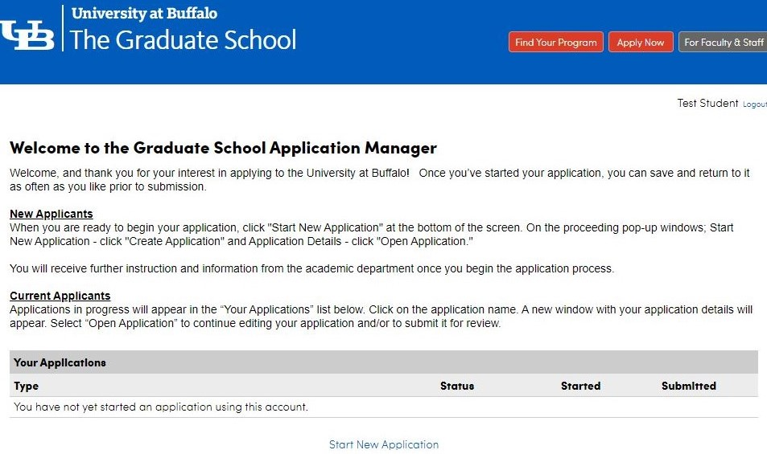
Click “Start New
Application”

Slide 16
You will complete the application called “The School of Public Health and Health Professions”
You will click “Create Application”

Slide 17
Once you create your application, an Application Details screen will pop up. You will then need to click “Open Application”

Slide 18
Once you open the application, you will go through each of the headings located on the left hand side.
In the first heading, “Program of Study”, for the Term, you will select: “Fall 2021”
The Degree Program will be: “Occupational Science/Occupational Therapy – BS/MS”

Slide 19
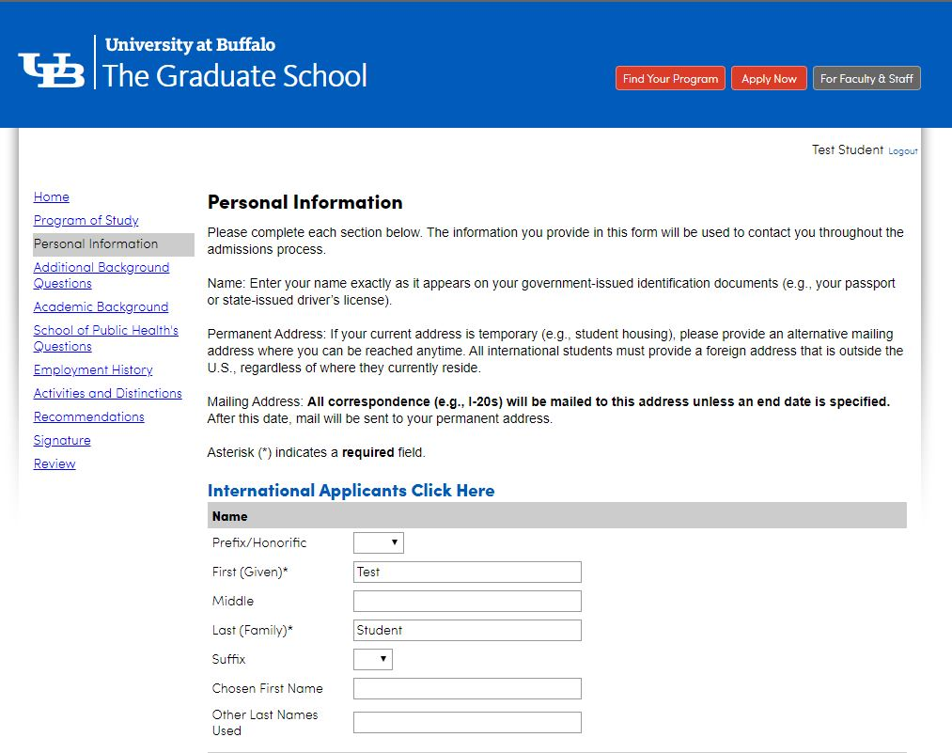
PERSONAL INFORMATION
You will then begin completing the section labeled: “Personal Information”
Key things to be aware of:
The “chosen first name” is your Preferred Name in hUB.
There are a variety of questions that are optional. They are marked.
All information submitted is private.

Slide 20
INTERNATIONAL APPLICANTS
If you are an international student, you will need to click on the link labeled “International Applicants Click Here”.
Within the application, you will have an additional tab to complete.

Slide 21
ADDITIONAL BACKGROUND INFORMATION
In this section you will provide information on:
If you partake in any EOP, HEOP, SEEK programs, etc.
If you are in the military or are a veteran.
If you have ever had an academic or non-academic dismissal.

Slide 22
ACADEMIC BACKGROUND
This section is required and must be completed.
All applicants must complete this section.

Slide 23
ACADEMIC BACKGROUND
As you type, the application will provide name suggestions.
Be sure to click on the school name you attended. When you do, it will auto populate with the school information.
You will need to upload an unofficial copy of your transcripts to this section for ALL institutions you have attended (including UB).
If you have taken classes at another institution and your courses have been articulated on your AAR, then you only need to upload UB transcripts.

Slide 24
SCHOOL OF PUBLIC HEALTH QUESTIONS
In this section, you will upload the following:
A copy of your AAR.
Your volunteer form.
You will also provide your personal statement.
Information
on how to
access your
AAR can be
found here.

Slide 25
PERSONAL STATEMENT
There is a 1500 word limit for the personal statement.
We recommend typing your personal statement in Microsoft Word so that you can review it, use word count and spell check.
Copy and paste your personal statement into the application.
Key things to remember:
Spell check.
Be mindful of the word limitation: If you have too many, your statement will be cut off!
DO NOT put your name on your personal statement! The Admissions Committee wants to review the personal statements anonymously.
Remember: Put your best foot forward!

Slide 26
SCHOOL OF PUBLIC HEALTH QUESTIONS
In this section, you will read the Technical Standards and make the selection that best applies to you. You will be able to access the OT Pre-Major Handbook to read the Technical Standards by clicking the link located here.
You will also provide additional background information. You may elect NOT to answer the background information questions by selecting “I Prefer Not to Respond”.

Slide 27
SCHOOL OF PUBLIC HEALTH QUESTIONS
You can also provide the following additional information:
if you come from an economically disadvantaged background
your language proficiency
explanatory notes
If you are an Honor’s College student, we ask that you put this information in the Explanatory Notes section and also email Jaclyn Levesque at the email address shown.
Additional information you can add in the Explanatory Notes:
If you will be moving in the middle of the spring semester. Be sure to indicate that here.
If you will be studying abroad or perhaps taking a leave of absence in the spring semester, indicate how we can reach you.

Slide 28
EMPLOYMENT HISTORY
This section can be left blank.
Information put here is NOT required and will NOT be reviewed.

Slide 29
ACTIVITIES AND DISTINCTIONS
This section is NOT required to be completed. HOWEVER, the Department may refer back to it if there are scholarship opportunities in the future.
You can complete this section but it is NOT required.
If you want us to know about any activities you have taken part in, we ask that you talk about that in your personal statement.

Slide 30
RECOMMENDATIONS
Letters of recommendation are NOT required, do NOT enhance your application and will NOT be reviewed.
Leave this section BLANK.

Slide 31
SIGNATURE
Your electronic signature is required prior to submitting your application.

Slide 32
REVIEW & SUBMIT
You will then reach the end of your application.
We encourage you to review your application prior to submitting it.
Once you feel you have completed everything, you can click “Submit Application”.
If you want to come back to it on another day, select “Save for Later”.
Be sure to save your log in information!

Slide 33
SUBMITTING your application
Be sure to review your application and that it is filled in completely before you submit it.
Partially completed applications will not be evaluated.
You may save your data and come back to finish completing your application at a different time. BE SURE TO KEEP YOUR LOG IN INFORMATION. MULTIPLE APPLICATIONS SEEN AS “IN PROCESS” WILL BE DELETED.
Be sure to officially submit your application once complete.
SAVED BUT UNSUBMITTED APLICATIONS WILL NOT BE CONSIDERED.
We are unable to make any changes to mistakes made in your application.

Slide 34
REVIEW
Once you have submitted your application, you will be at the Review screen and it will look like this.
Simply click “Save for Later”.

Slide 35
ADDITIONAL INFORMATION TO KNOW

Slide 36
WHAT HAPPENS AFTER YOU SUBMIT YOUR APPLICATION
After you submit your application, you will be prompted to remit the $50 application fee. There will be a link for you to click to remit payment.
It can take anywhere from 2 – 24 hours for supplemental materials that you have uploaded to appear in your checklist.
If you have submitted your volunteer form early, or if you are reapplying and have requested that your volunteer hours brought forward, Jaclyn Levesque can upload your hours to your application. You can email her at jl388@buffalo.edu. It can take up to 24 hours for that information be appear as having been received in your checklist.

Slide 37
INFORMATION ON PREREQUISITES
12 prerequisites are required.
Of those 12, 8 prerequisites MUST be completed before you apply.
These 8 must include:
ES 207 –Human Form/Function
OT 201 – Introduction to Occupational Therapy
PHY 101 – College Physics I
STA 119 (or PSY 207) – Statistical Methods
Follow your advisor’s recommendations in determining your prerequisite course plan.
Prerequisites taken over 5 years ago must be reviewed and approved by MaryAnn Venezia. You will need to send her an email to tell her if any of your prerequisite courses are over 5 years old.
If you are taking a prerequisite course outside of UB, be sure to let MaryAnn Venezia know.

Slide 38
TRANSFER COURSES: ARTICULATING GRADES
What does this mean?
Articulation refers to the process of comparing the content of the courses that are transferred between educational institutions and deciding if they are equivalent.
A course MUST be articulated through UB to be used as a prerequisite.
OR
The syllabus must be reviewed and accepted for program credit.

Slide 39
RETAKING COURSES
You may repeat up to 2 prerequisite courses.
As stated in the UB Catalog, all second attempt grades will count as your official grade, regardless whether it is better or worse. The second grade that you earn will be the one that we look at.
If you received lower than a C- in a course, but will be retaking the course this Spring, email us to let us know.
To learn more about the repeat policy on courses, click this link:
https://catalog.buffalo.edu/policies/repeat.html

Slide 40
GENERAL EDUCATION OR
UB CURRICULUM REQUIREMENTS
Students must either have:
All general education requirements completed before entering the program/before beginning PAS 407.
OR
They must have their UB curriculum courses completed.
The only UB curriculum course completed in the Professional Program is UBE 399 (Capstone). It is taken in the spring semester of the first year of the professional program. All other UB curriculum courses must be completed.

Slide 41
Reminder:
Failure to provide the required and accurate information may prevent your application from being processed.
Check your email on a regular basis. You are responsible for the information and notices sent to your UB email address.

Slide 42
OFFICIAL TRANSCRIPTS FOR COURSES NOT TAKEN AT UB
All applicants must be enrolled as an undergraduate student at UB when applying to the program.
If you are taking any courses in Fall 2019, Winter 2019 or Spring 2020 semesters outside of UB, you must send your official transcripts to:
MaryAnn Venezia, Coordinator for Professional Programs
Department of Rehabilitation Science
SUNY at Buffalo, South Campus
3435 Main Street
523 Kimball Tower
Buffalo, NY 14214

Slide 43
DECISION LETTERS
Decision letters will be sent out by the end of March. Everyone will be notified at the same time. You will either be accepted, offered a place on the wait list or your application will be declined/rejected.
ACCEPTANCE
If you receive an acceptance letter, you must respond by accepting or declining your spot in the program by the stated deadline found in the letter.
Acceptance is conditional and is based on the successful completion of all prerequisite courses in the spring semester. Grades will be checked at the end of the semester.
WAIT LIST
Some students who are not initially accepted into the program may be invited to be placed on a wait list.
If you receive an wait list letter, you must respond by accepting or declining your spot in the program by the stated deadline found in the letter.
Waitlisted students MUST take PAS 407, Human Gross Anatomy in Summer 2020.

Slide 44
IF I DON’T GET ACCEPTED, WHAT DO I DO?
Schedule a follow-up meeting with the Office for Academic and Student Affairs (OASA)
104B Kimball Tower
716-829-5000 (call or email for an appointment)
sphhp-oasa@buffalo.edu
Career Services
Call 716-645-2231 to make an appointment.
Students are strongly encouraged to schedule appointments with these offices to discuss their future plans.

Slide 45
Important contact information
For questions about volunteer forms or application procedures, you can contact:
Jaclyn Levesque
Admissions Coordinator
jl388@buffalo.edu
For questions about the application process and to request course approvals, you can contact:
MaryAnn Venezia
Coordinator for Professional Programs
venezia3@buffalo.edu

