Slide 1
Four Models to Guide AT Projects Intending Innovative Technology Development Outcomes
Joseph P. Lane
Center on Knowledge Translation for Technology Transfer (KT4TT)
University at Buffalo (SUNY), USA
http://sphhp.buffalo.edu/cat/kt4tt.html
AAATE 2017
Sheffield, England

Slide 2
Need for Innovation Models in AT
Many AT projects under EU Framework Programmes, US Engineering Centers and other initiatives are expected to generate innovative technology-based outcomes.
Most grants go to university-based faculty or corporate entrepreneurs with expertise in scientific research or engineering development but not typically both together.
Few grantees have planned, implemented and managed projects through technology transfer or commercialization.
This creates a gap between sponsor expectations and grantee deliverables, resulting in few AT outcomes – a real problem!

Slide 3
Who are Intended Beneficiaries?
New Models help grantees plan, implement and manage projects to increase odds of success – still no guarantees!
These Models to be useful to various stakeholders:
Grantees/Grant Applicants – They serve as templates for framing proposed project inputs, processes and outputs; They link outputs to outcomes through Knowledge Translation & Technology Transfer options.
Project Sponsors – The Models help review panels ensure proposals plan and budget for all requirements, and help sponsors monitor progress.
All Applied Researchers and Engineers – The Models provide a research, development and production continuum, to justify project initiation, continuation and eventual delivery of beneficial innovative AT outcomes.

Slide 4
NtK Model Evolution
NtK Model for Commercial Products (2009 – 2011) – Integrated international industry best practices with tools to assess requirements, and communicate/transfer project outputs.
Evidence-Based – Supported by excerpts drawn from academic and industry literature, and examples of standard tools for conducting required technical, market and customer analysis.
Stage/Gate Design – Demonstrates why Stage Activities and Decision Gates are equally important to rigorous progress.
Detailed Guidance – The NtK Model serves as a tool during proposal preparation, and post-award implementation.

Slide 5
Three NtK Model Variants
NtK Model Variants (2014 – 2016) – Stakeholder feedback verified need for NtK Model variants to guide projects intending non-commercial outcomes:
Industry Standards / Clinical Guidelines.
Laboratory Instruments / Fabrication Tools.
Freeware Applications / DIY Instructions.

Slide 6
Common Trunk in All NtK Models
All four NtK Models share all elements of Research Phase – Verify and Validate to avoid fatal assumptions:
Problem Definition – Validate problem in context of targeted beneficiary group & Verify feasibility of envisioned solution in Stakeholder context.
Solution Scoping – Identify all current and past alternative solutions & Seek other potential applications for envisioned outcomes.
Objectively Assess Need for Research – Gather relevant knowledge from all fields & determine if new scientific research is justified.

Slide 7
Three NtK Variants Branch Off Trunk
Commercial Product version requires the most extensive investment in engineering development and industrial production activities and decisions.
Variants all require less elaborate prototyping fabrication and testing, and face fewer regulatory and financial hurdles beyond key collaborators.
Each variant model harbors unique attributes as detailed in following three slides.

Slide 8
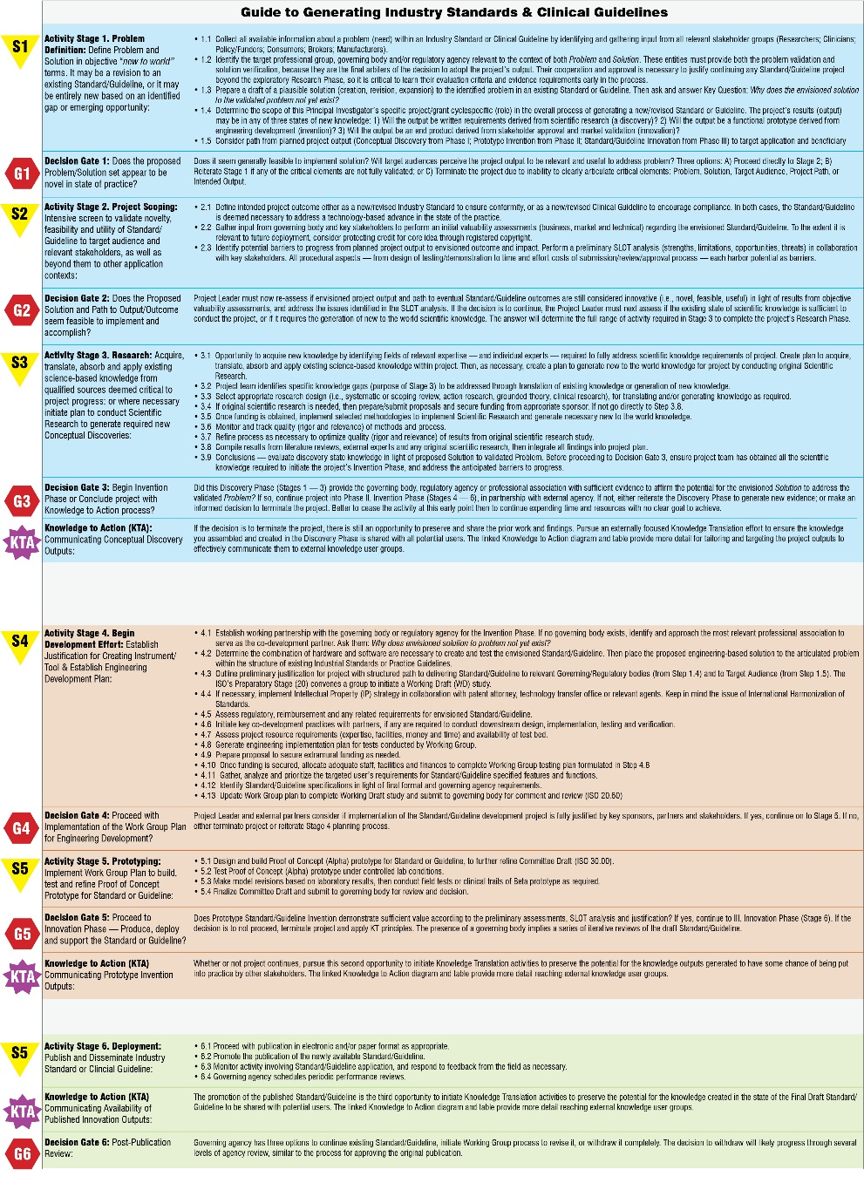
Standards/Guidelines Key Feature
Lead Role for External Organizations – Critical to first identify the target professional group, governing body and/or regulatory agency, along with their evaluation criteria and evidence requirements. Tailor project and subordinate role to their requirements as they are the final arbiters of the decision to transform outputs into outcomes.

Slide 9
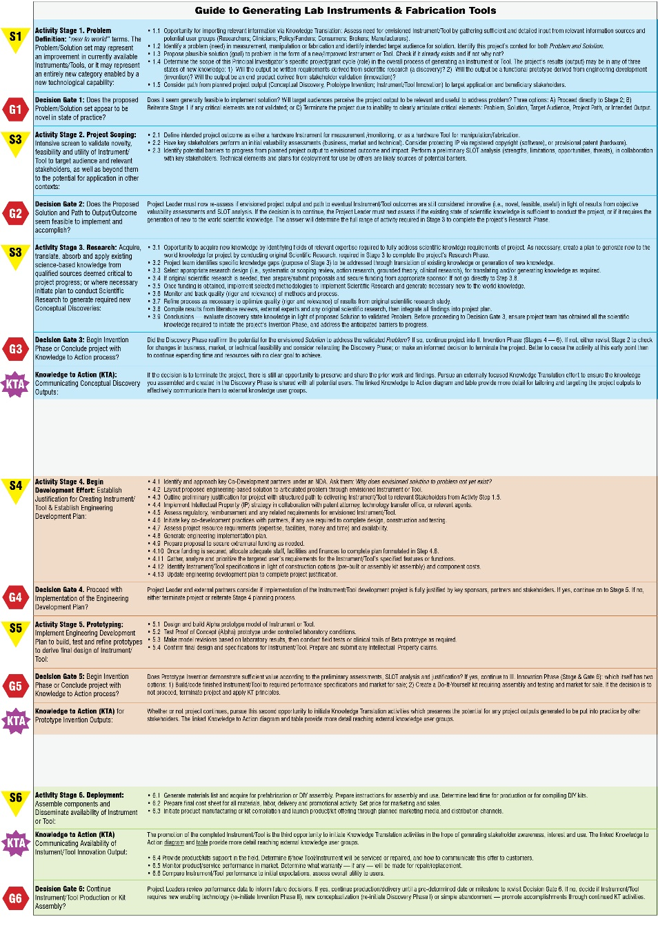
Instruments/Tools Key Feature
Lack of Defined Customer: In most instances Grantees design, build and test new Instruments/Tools for use within their own scientific research or engineering development projects. So this approach represents an effort to offer this internal output for adoption and use by external stakeholders.

Slide 10
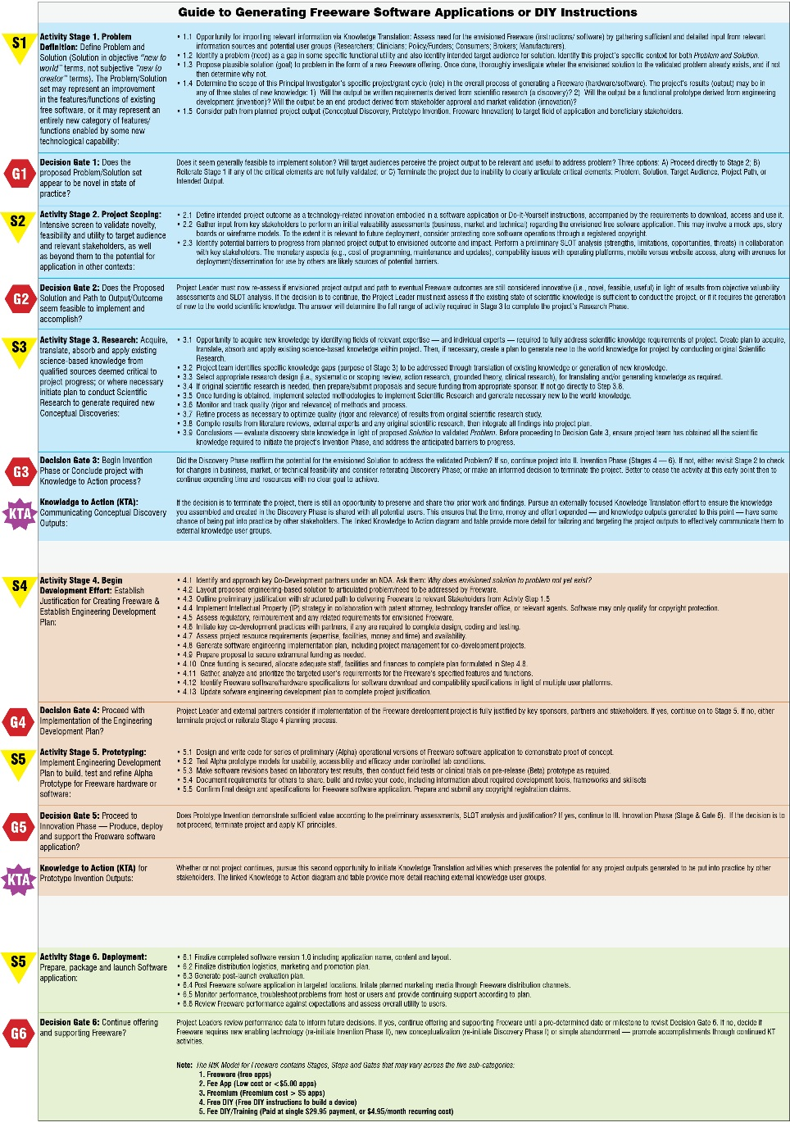
Freeware Variant Key Feature
Implications of Sub-Categories: There are five sub-categories, each influencing the actions taken and decisions made:
1. Freeware (No cost apps)
2. Fee App (Low cost or <$5.00 apps)
3. Freemium (Cost > $5 apps)
4. Free DIY (Free DIY instructions to build a device)
5. Fee DIY/Training (Single charge $29.95 or $4.95/month recurring cost)

Slide 11
All Four NtK Models Live on Website
http://sphhp.buffalo.edu/cat/kt4tt/best-practices/need-to-knowledge-ntk-model/
ntk-commercial-devices.html
ntk-freeware.html
ntk-instrument-tool.html
standards-guidelines.html

Slide 12
ACKNOWLEDGEMENT
The contents were created under a cooperative agreement from the National Institute on Disability, Independent Living, and Rehabilitation Research (#90DP0054). NIDILRR is a Center within the Administration for Community Living (ACL), Department of Health and Human Services (HHS).
The contents do not necessarily represent the policy of NIDILRR, ACL, HHS, and you should not assume endorsement by the Federal Government.

